Slide 1
Music Data Mining Finding Structure in Song
Nicholas Landry

Slide 2
Motivation
Collaboration with Nature, Environment, Science & Technology (NEST) Studio for the Arts
Answering the question, “Music has many auditory structural components – can we visualize these through sculpture or image in a way that ‘makes sense?’”
No new research – simply exploring what is out there.
Major Books used :
“Music Data Mining” edited by Li, Ogihara, Tzanetakis
“Music Similarity and Retrieval” by Knees and Schedl

Slide 3
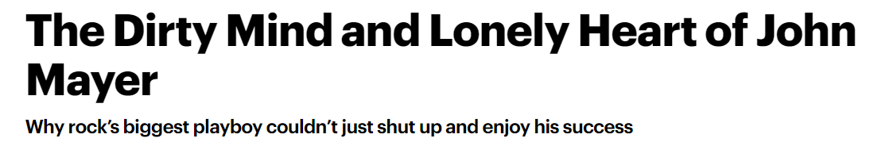
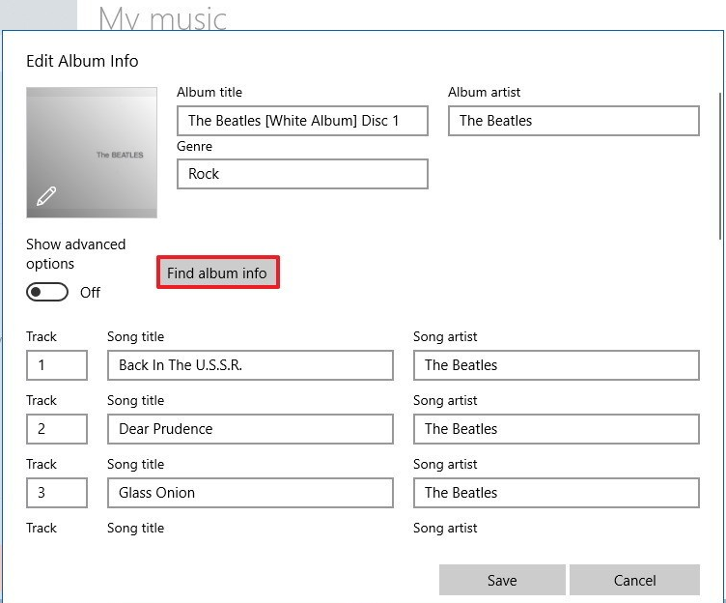
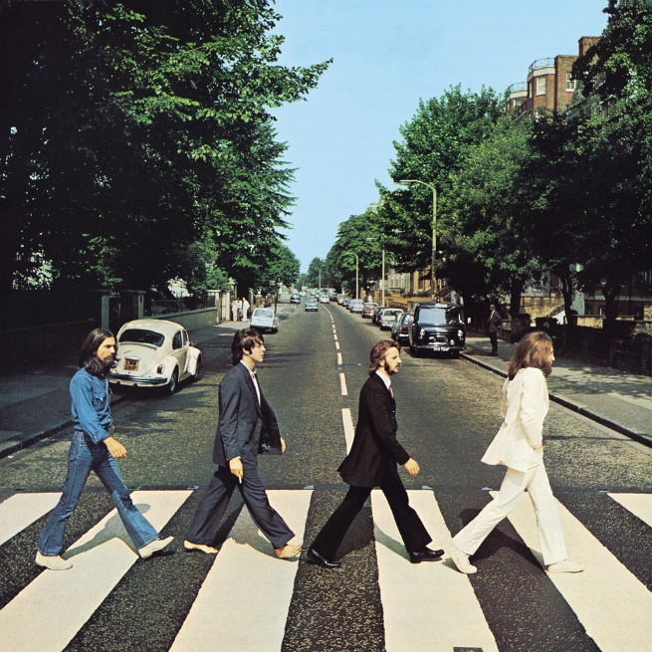
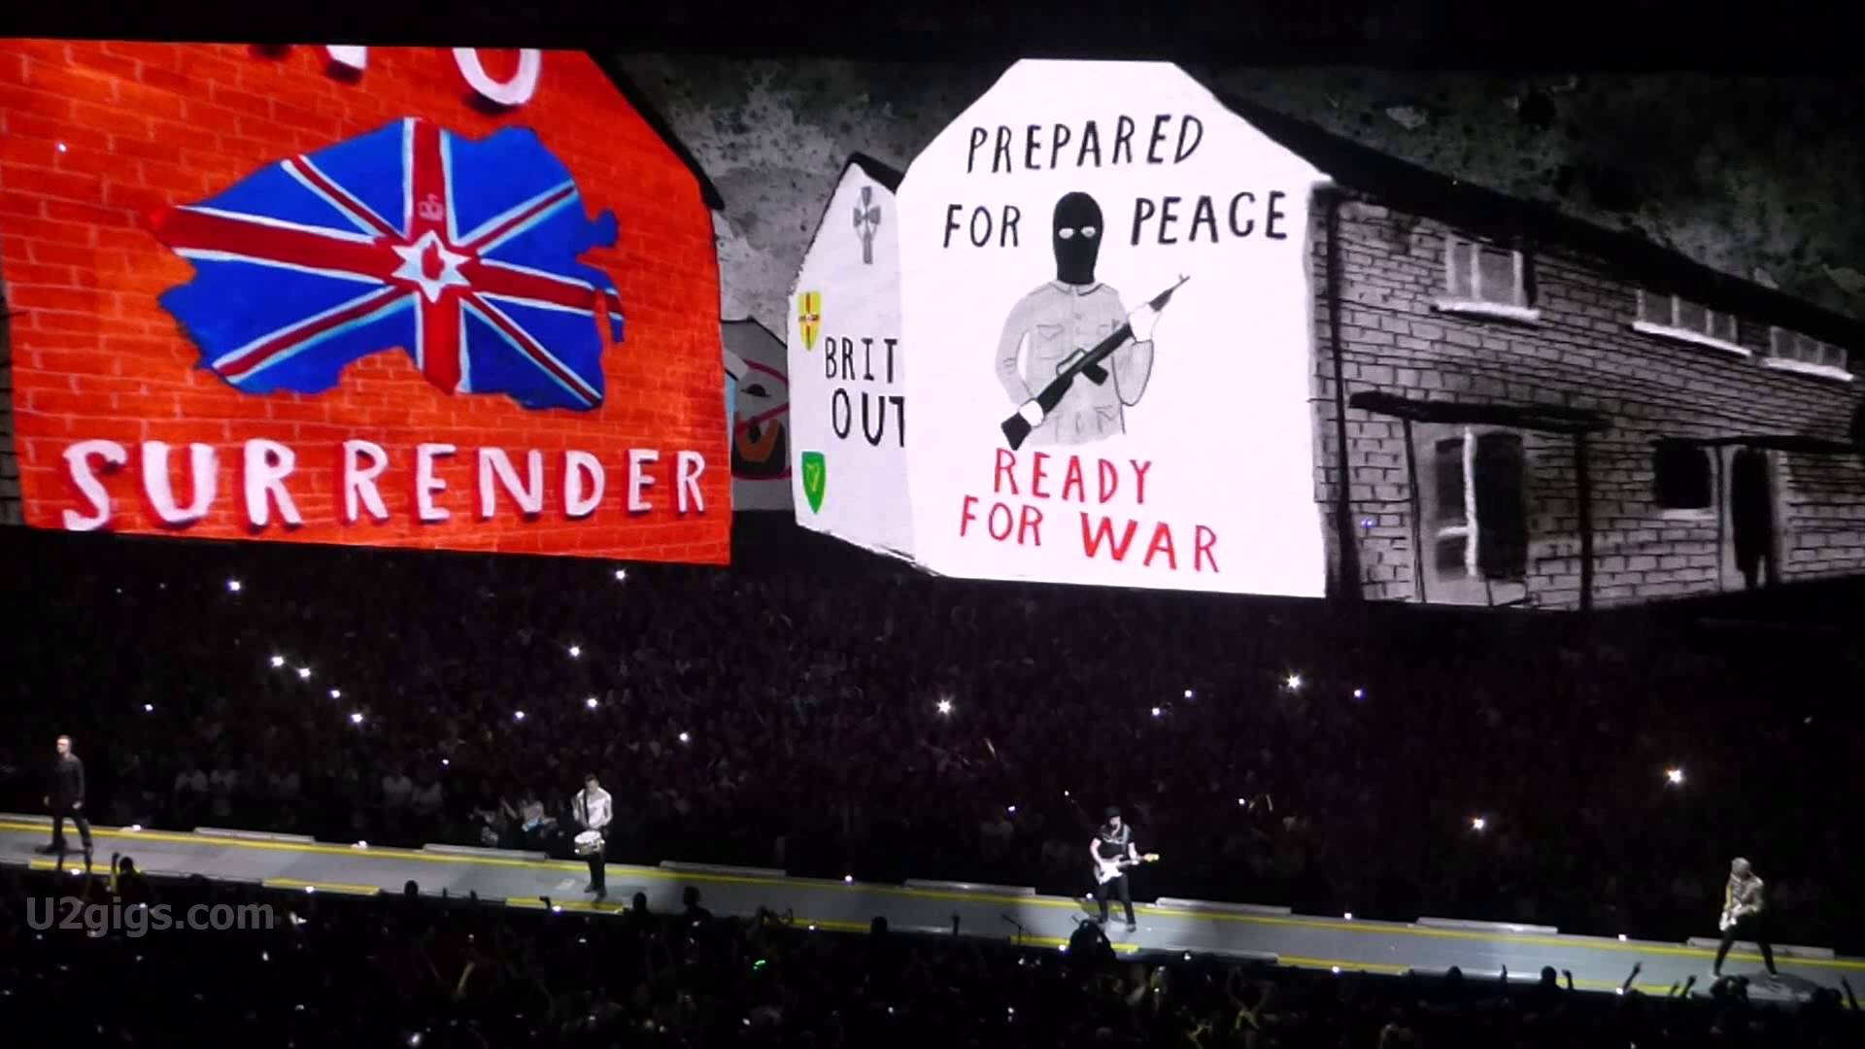
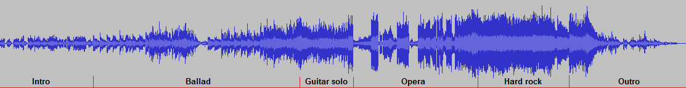
Context for Music Information
Meta-Data
Perception of the Artist
Album Artwork
Societal Implications
CD/Vinyl/MP3
Audio File
Bohemian Rhapsody

Slide 4

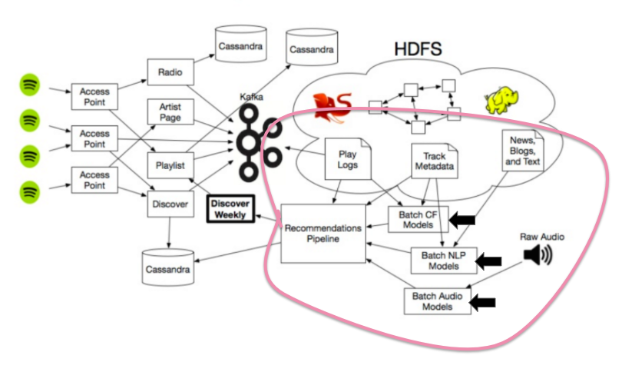
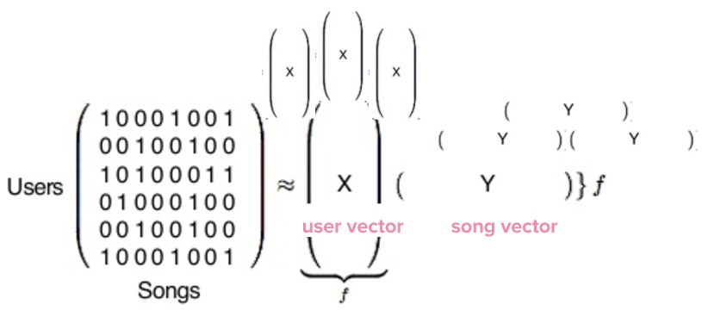
Computing Music Similarity
Waveform
Song Structure
Bach: Goldberg Variations
Schematic of Spotify Similarity Computation
Network-Based

Slide 5
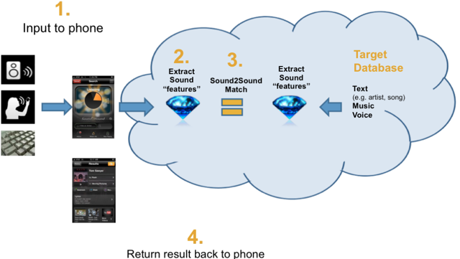
Some companies that compute music similarity
Shazam
SoundHound
Spotify
Basic Schematic
?
In reviews of SoundHound vs. Shazam, some majors themes:
Deals well with background white noise, but terrible with background conversation
The closer to the music source the better

Slide 6
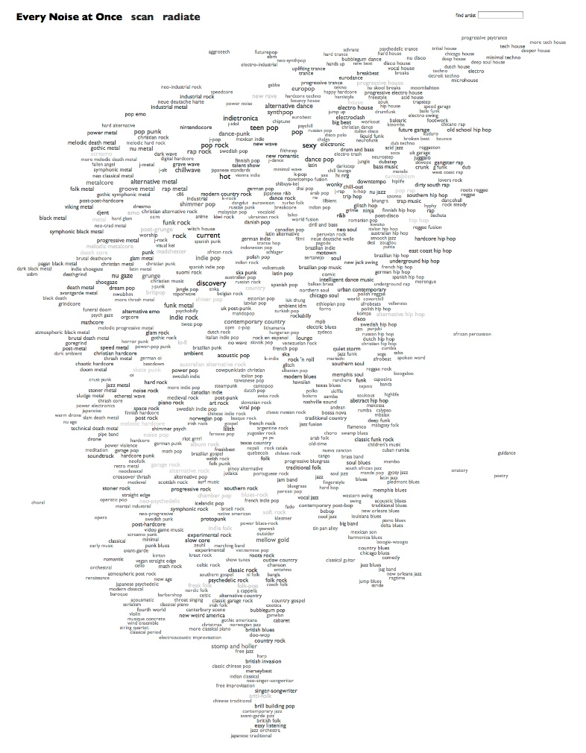
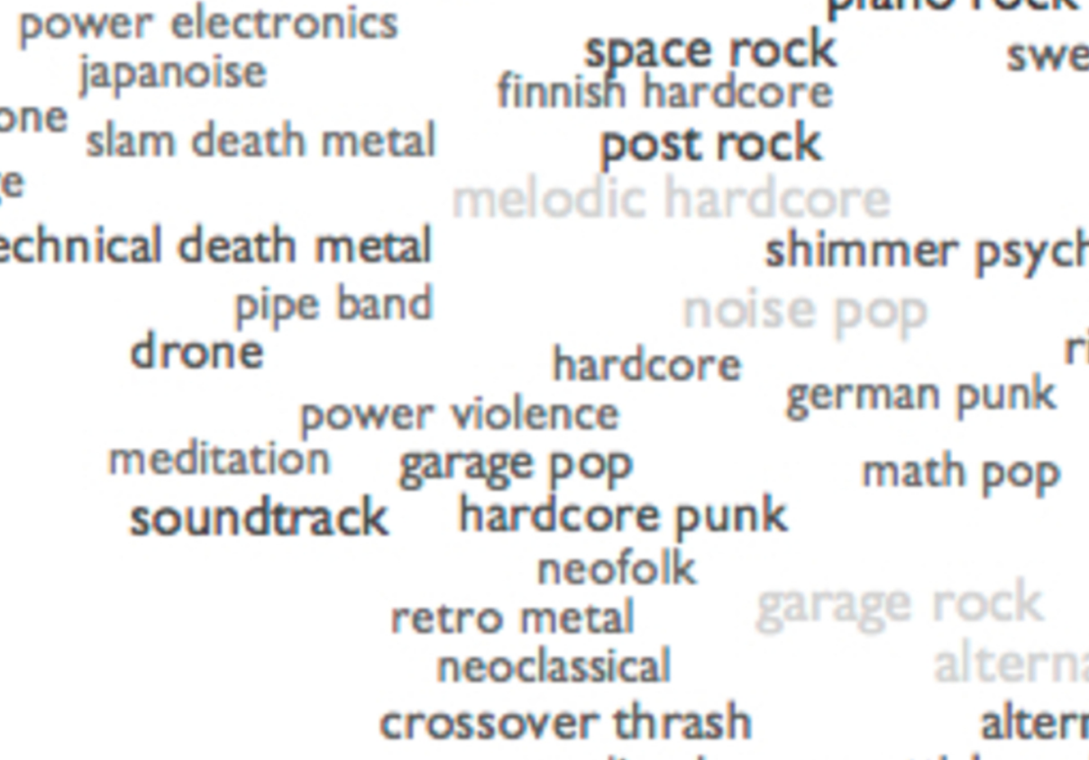
Examples of music similarity
Everynoise.com
“an ongoing attempt at an algorithmically-generated, readability-adjusted scatter-plot of the musical genre-space, based on data tracked and analyzed for 2,250 genres by Spotify as of 2018-11-02”

Slide 7
Different Ways to Analyze a Waveform
Statistical Properties of signal
Zero Crossing Rate (Percussion and Noise)
RMS Energy (Sound Intensity)
Spectral Centroid (Brightness/Timbre)
Band Energy Ratio (Speech vs. Music)
Spectral Flux
Etc.
Harmonic Properties
FFT (Converting Time Domain to Frequency Domain)
STFT (Distribution of frequencies at each instant in a song (short sample))
MFCCs

Slide 8
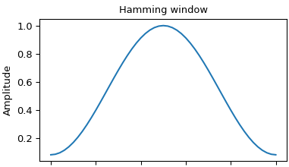
Harmonic Analysis
……………..
Frame Size
Hamming window ensures periodicity for FFT
Hop Size

Slide 9
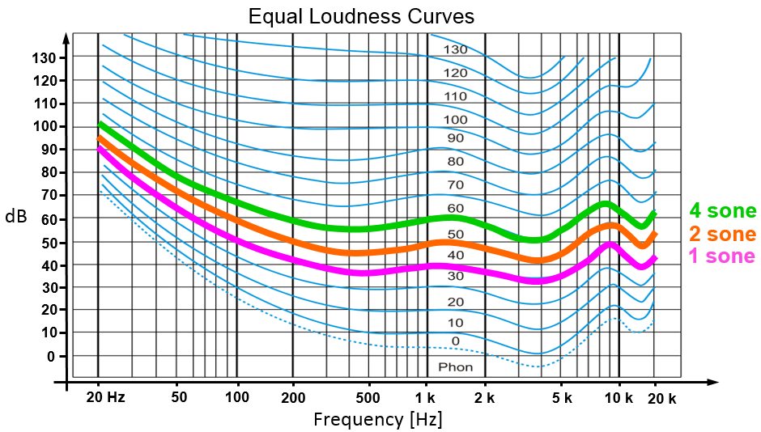
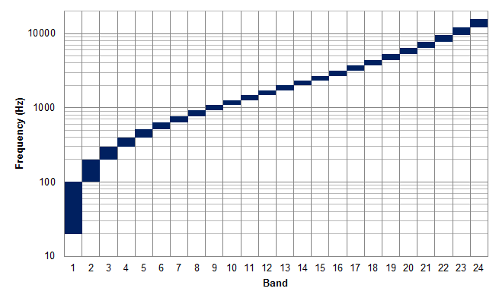
Relative Nature of Pitch and Intensity
Sone Scale (Relative Loudness)
Bark Scale (Relative Frequency)
Sone and Phon scales are empirically determined
Bark, Mel, ERB scales are empirically determined

Slide 10
Harmonic Features: STFT
STFT Computes the FFT at each sample frame in the song
Sample of Rock Music
Sample of Jazz Music

Slide 11
What are MFCCs?
1
2
3
Discrete Cosine Transform
Log of FFT
4
5

Slide 12
Harmonic Features: MFCCs
Rock Genre
Jazz Genre

Slide 13
Basic Applications of Machine Learning: K-Means Clustering or EM
**From the Rock Genre

Slide 14
From the Latin-Jazz Genre

Slide 15
From Neo-Classical Genre

Slide 16
Conclusions
Analyzing music similarity is a broad topic (and subjective) because it is dependent on perception of listeners
Can analyze an audio file many different ways
Can compare two songs using the clusters described by their MFCCs
Discussed general tools as a foundation for music comparison when comparing salient features

Slide 17
References
http://josephrheeanalysis-blog.tumblr.com/
https://www.windowscentral.com/how-edit-music-metadata-information-windows-10
https://www.youtube.com/watch?v=0WjpeaqLXwc
http://turbulence.org/Works/song/
https://medium.com/s/story/spotifys-discover-weekly-how-machine-learning-finds-your-new-music-19a41ab76efe
https://www.speech.kth.se/~giampi/auditoryscales/
https://www.lifehacker.com.au/2011/02/shazam-vs-soundhound-battle-of-the-mobile-song-id-services/

Slide 18
Questions?

